Slide 1
Design Patterns Introduction

Slide 2
What is a Design Pattern?
A (Problem, Solution) pair.
A technique to repeat designer success.
Borrowed from Civil and Electrical Engineering domains.

Slide 3




How Patterns are used?
Designer
  Design Problem.
  Solution.
  Implementation details.
Programmer
Reduce gap
Design
Implementation
Gamma, E., Helm, R., Johnson, R., Vlissides, J.: Design patterns: elements of reusable object-oriented software. 1995.
Buschmann, F., Meunier, R., Rohnert, H., Sommerlad, P., Stal, M.: Pattern-oriented software architecture: a system of patterns. 2002.

Slide 4
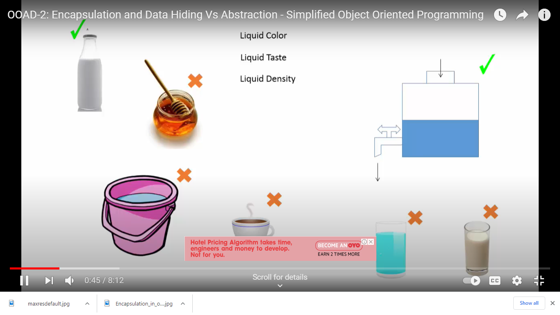

Slide 5
Shelter from hot sun ,wind, rain - HUT
Concrete building
Optimum utilization of space- Apartments

Slide 6
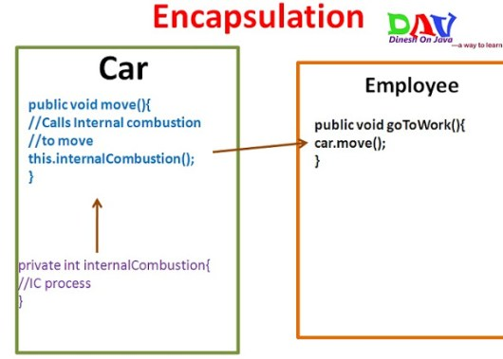

Slide 7
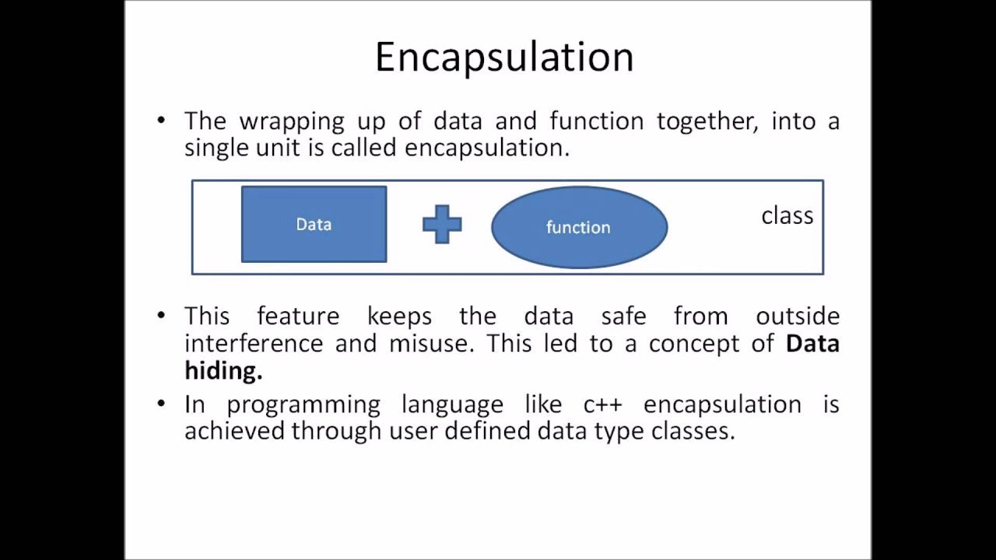

Slide 8
Encapsulation in Java is a mechanism of wrapping the code and data (variables)acting on the data (methods) together as a single unit. In encapsulation, the variables of a class will be hidden from other classes, and can be accessed only through the methods of their current class. Therefore, it is also known as data hiding.

Slide 9
Design patterns you have already seen
Encapsulation (Data Hiding)
Subclassing (Inheritance)
Iteration
Exceptions

Slide 10
Encapsulation pattern
Problem: Exposed fields are directly manipulated from outside, leading to undesirable dependences that prevent changing the implementation.
Solution: Hide some components, permitting only stylized access to the object.

Slide 11
Subclassing pattern
Problem: Similar abstractions have similar members (fields and methods). Repeating these is tedious, error-prone, and a maintenance headache.
Solution: Inherit default members from a superclass; select the correct implementation via run-time dispatching.

Slide 12
Iteration pattern
Problem: Clients that wish to access all members of a collection must perform a specialized traversal for each data structure.
Solution: Implementations perform traversals. The results are communicated to clients via a standard interface.

Slide 13
Exception pattern
Problem: Code is cluttered with error-handling code.
Solution: Errors occurring in one part of the code should often be handled elsewhere. Use language structures for throwing and catching exceptions.

Slide 14
Derived Conclusion
Patterns are Programming language features.
Programming languages are moving towards Design.
Many patterns are being implemented in programming languages.

Slide 15
Pattern Categories
Creational Patterns concern the process of object creation.
Structural Patterns concern with integration and composition of classes and objects.
Behavioral Patterns concern with class or object communication.

Slide 16
What is the addressing Quality Attribute?
Modifiability, Exchangeability, Reusability, Extensibility, Maintainability.
What properties these patterns provide?
More general code for better Reusability.
Redundant code elimination for better Maintainability.

Slide 17
Design pattern example

Slide 18
Some examples of Design Patterns

Slide 19
Template for discussion
Non-software example.
Pattern intent.
Software counterpart example.
Non-software examples are derived from paper
& PPT – “Non-software examples of software
design patterns” (OOPSLA 97).

Slide 20
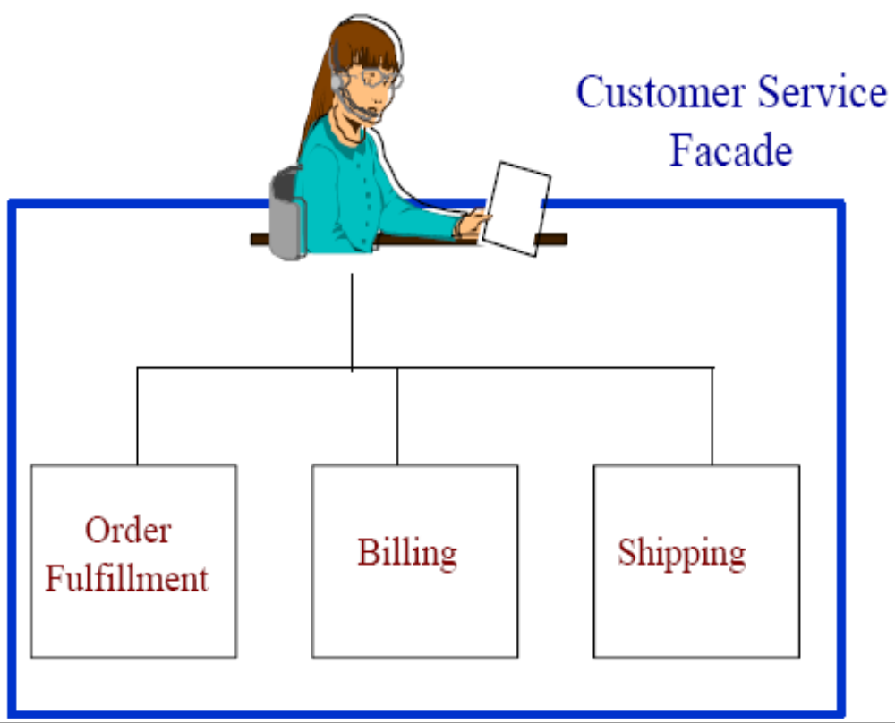
Facade (Non software example)
Provide a unified
interface to a set
of interfaces in a
subsystem.

Slide 21
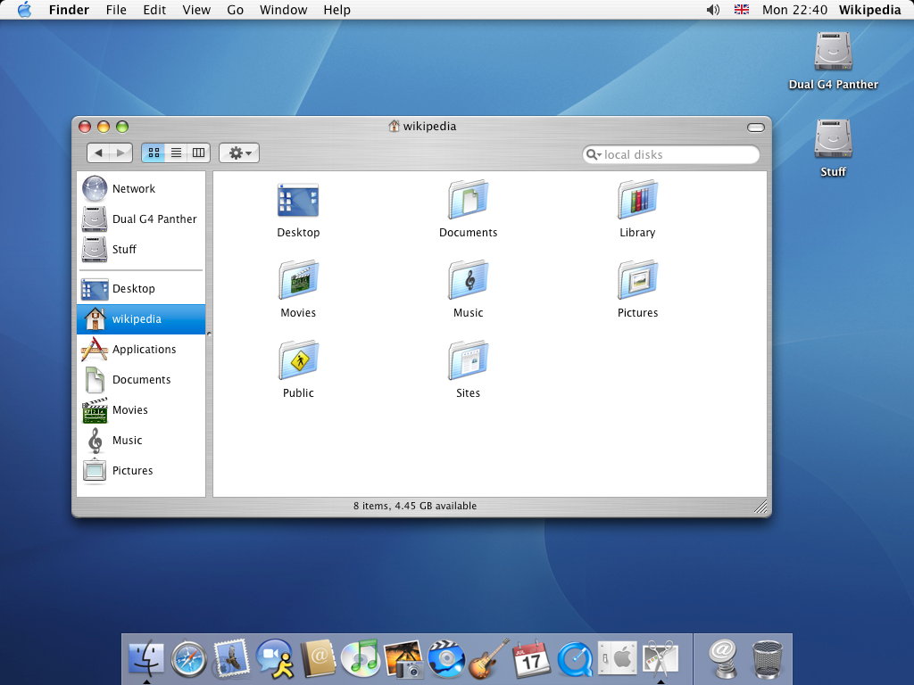

Facade (Software counterpart)

Slide 22
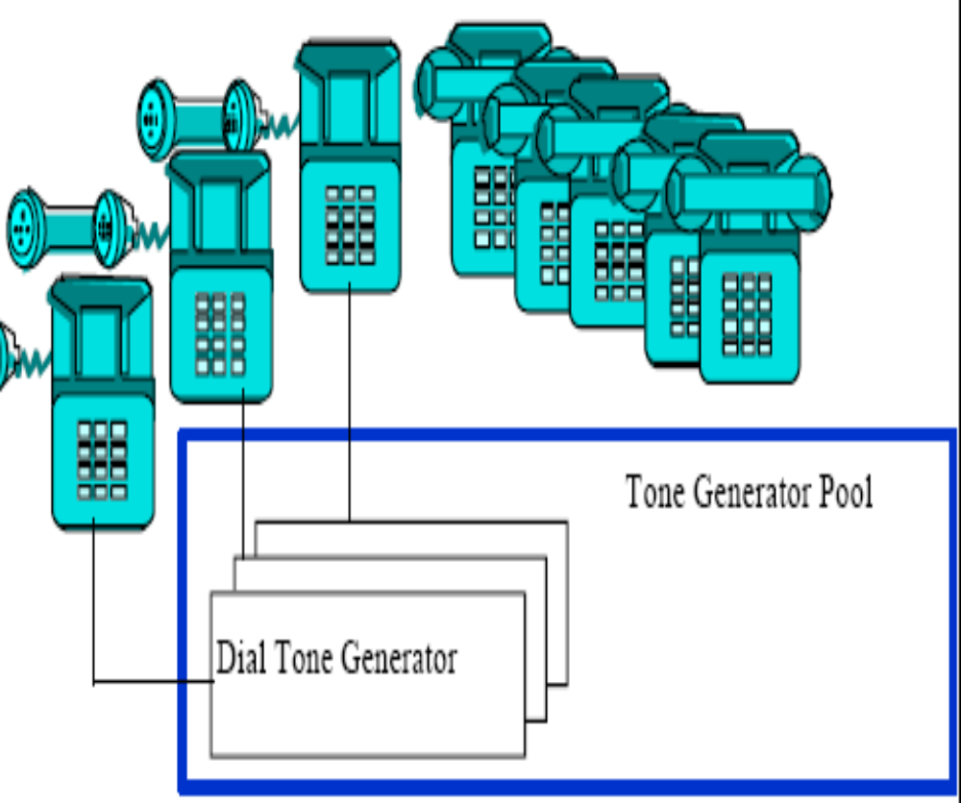
Flyweight (Non software example)
Use sharing to
support large
numbers of fine-
grained objects
efficiently

Slide 23
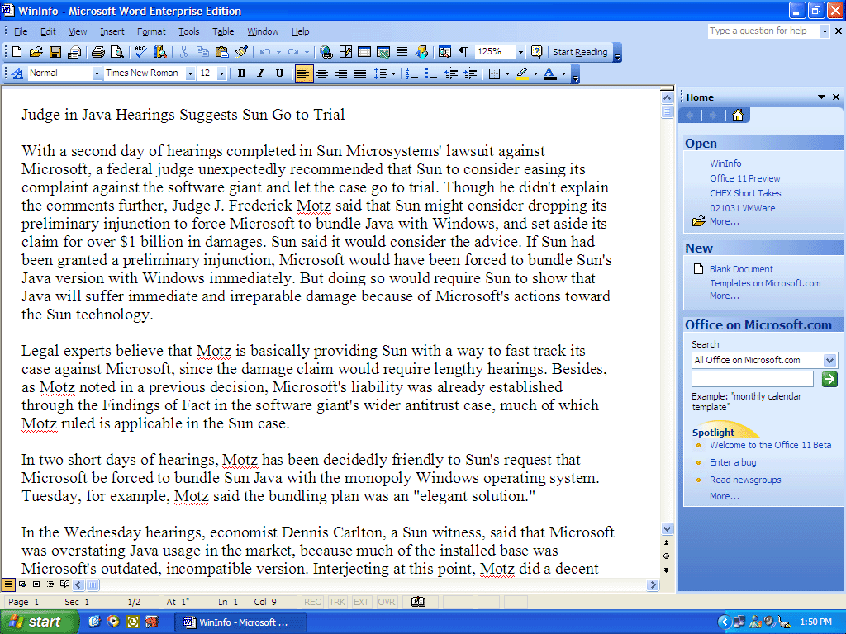
Flyweight (Software counterpart)
Memory

Slide 24
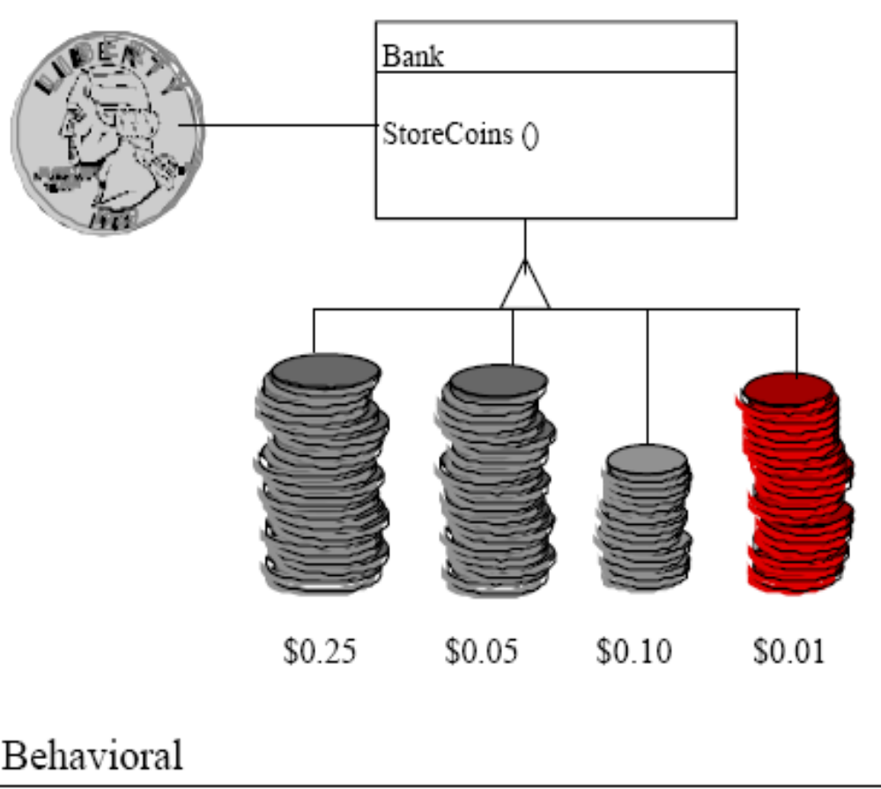
Chain of Responsibility (Non software example)
Chain the
receiving objects
and pass the
request along the
chain until an
object handles it.

Slide 25
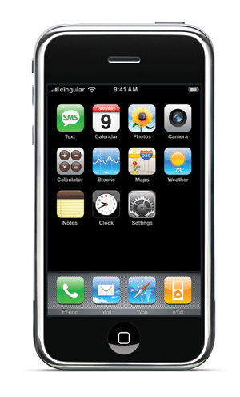
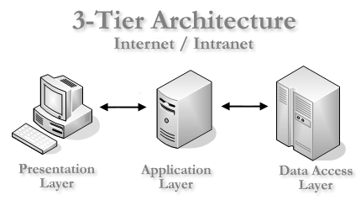
Chain of Responsibility (Software counterpart)
Internet
Login page
Password checking
Balance statement

Slide 26
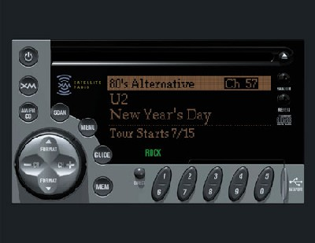
Memento (Non software example)
Externalize
object’s state so
that object can be
restored to this
state later.

Slide 27
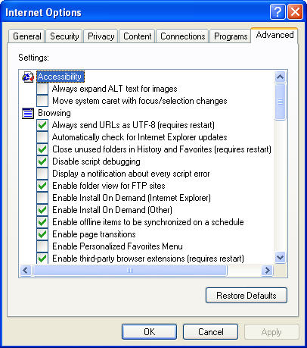
Memento (Software counterpart)

Slide 28
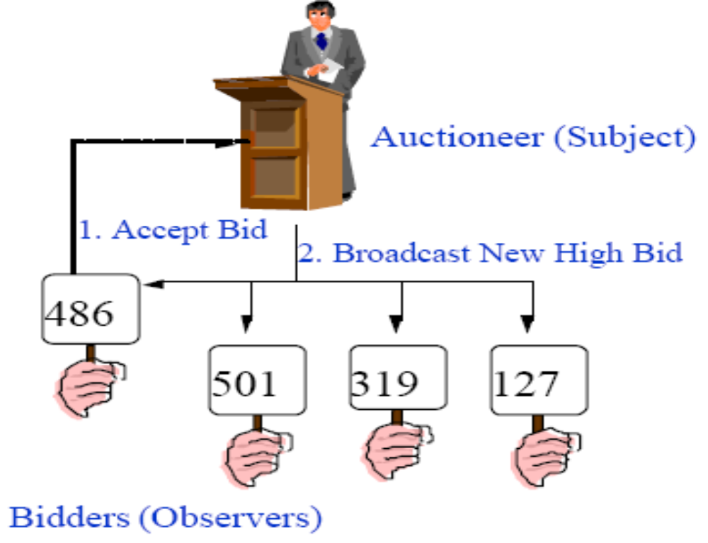
Observer (Non software example)
When an object
changes its state,
all its dependants
are notified.

Slide 29

Observer (Software counterpart)
Internet
Cricinfo Server

Slide 30
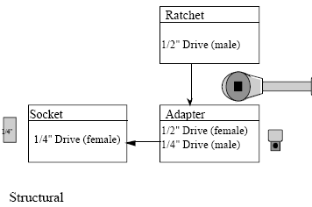
Adapter (Non software example)
Convert the
interface of a
class into another
Interface clients
expect.

Slide 31
Adapter (Software counterpart)
Java module
Java Native
Interface (JNI)
C++ module

Slide 32
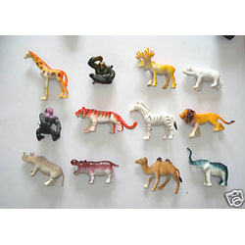
Builder (Non software example)
Separate the construction
process of a complex object
from its representation so
that the same construction
Process can create different
representations.

Slide 33
Builder (Software counterpart)
Compiler process
Lexical
analysis
Syntax
analysis
Semantic
analysis
Intermediate code
Interpretation
Java Compiler
Java Lexer
Java Parser
Semantic
analysis
Java byte code
JVM
Python Compiler
Python Lexer
Python Parser
Semantic
analysis
Python byte code
PVM

Slide 34
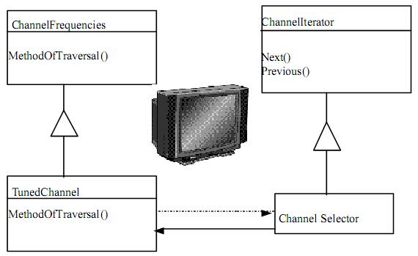
Iterator (Non software example)
Provide a way to
access the
elements of a set
sequentially.

Slide 35
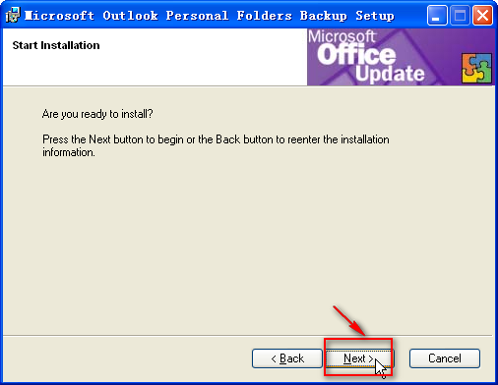
Iterator (Software counterpart)

Slide 36
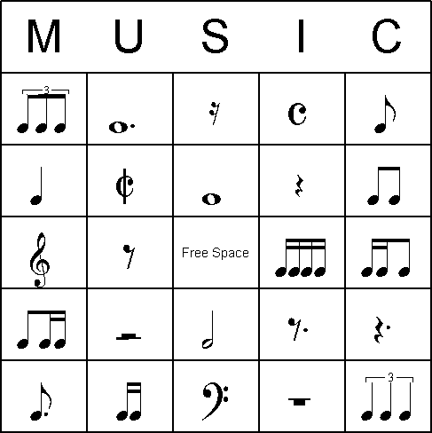
Interpreter (Non software example)
Interpreter interprets
the sentences in a
language based
on its grammar.

Slide 37
Interpreter (Software counterpart)
In Gtalk/Yahoo messengers
:-) is interpreted as ☺
:-( is interpreted as ☹

Slide 38

Broker (Non software example)
Broker component is
responsible for
coordinating
communication
between clients and
remote servers.

Slide 39
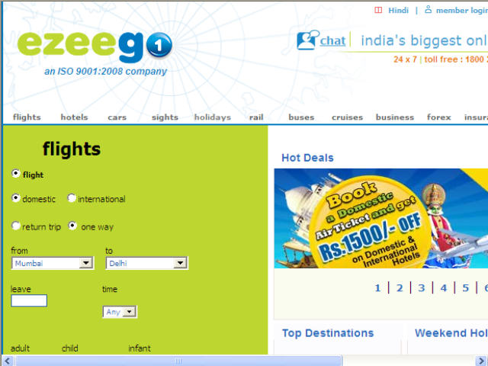
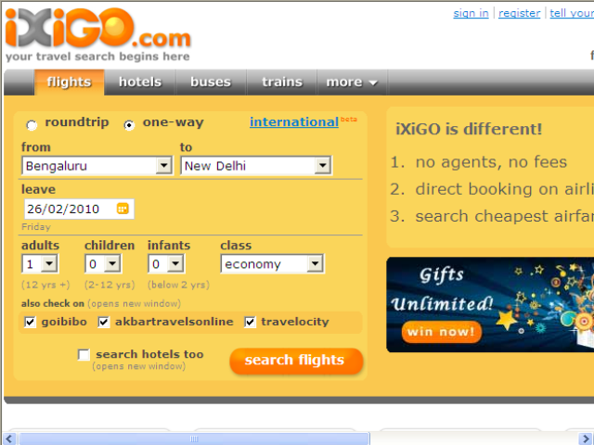
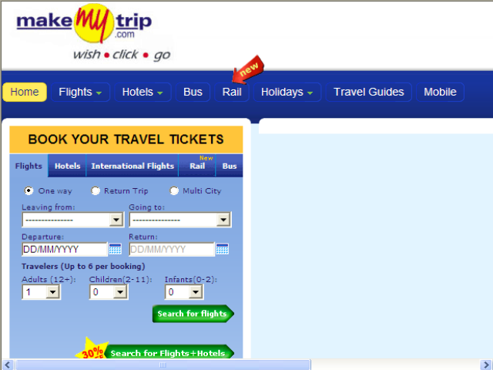
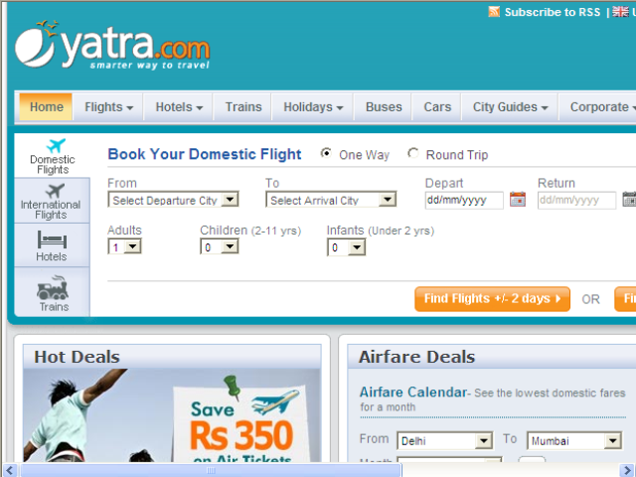
Broker (Software counterpart)

Slide 40
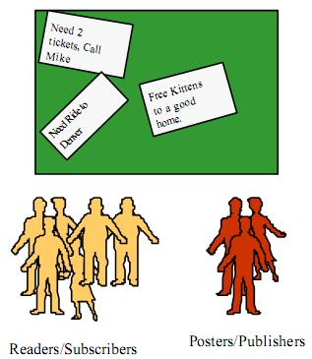
Publisher-Subscriber (Non software example)
Publishers register
themselves to a
broker and
subscribers discover
publisher from broker.

Slide 41
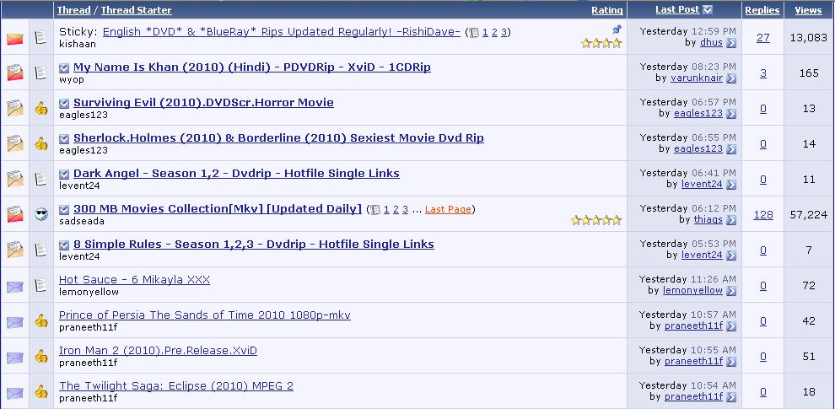
Publisher-Subscriber (Software counterpart)
Forums (e.g. movie forums)

Slide 42
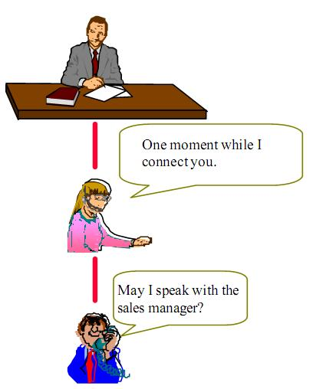
Proxy (Non software example)
Provide a surrogate or
placeholder for
another object to
control access to it.

Slide 43
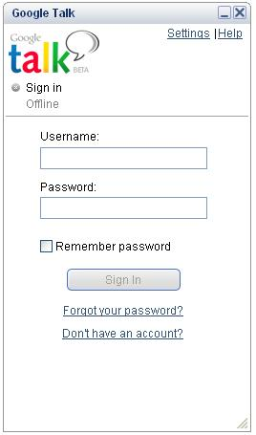
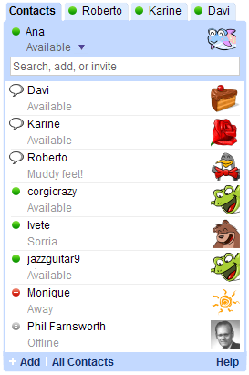

Proxy (Software counterpart)

Slide 44
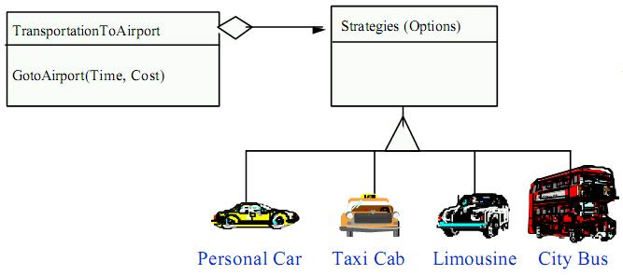
Strategy (Non software example)
A Strategy defines a set of algorithms that can be
used interchangeably.

Slide 45

Strategy (Software counterpart)
Multiple
interchangeable
weapons available to
attack an enemy.

Slide 46
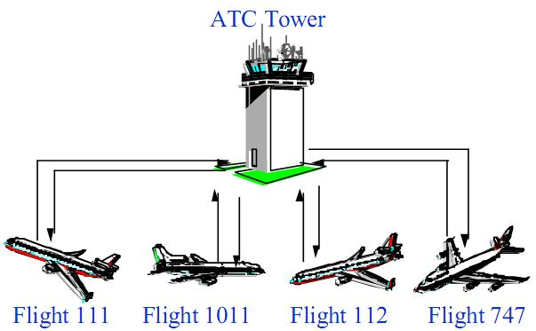
Mediator (Non software example)
Loose coupling
between colleague
objects is achieved by
having colleagues
communicate with the
Mediator, rather than
one another.

Slide 47
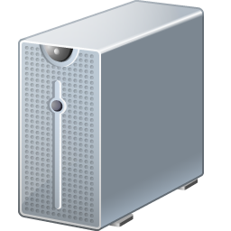
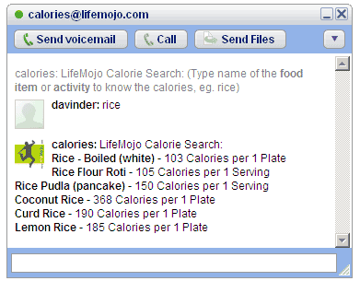
Mediator (Software counterpart)
Gtalk Server

Slide 48
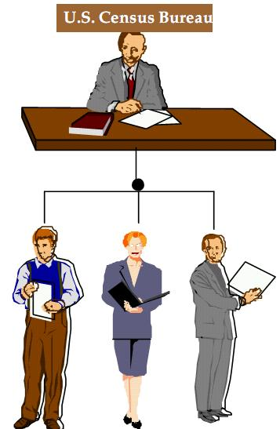
Master-Slave (Non software example)
Master component
distributes work to
identical slave
components and
computes a final
result from the results
when the slaves
return.

Slide 49
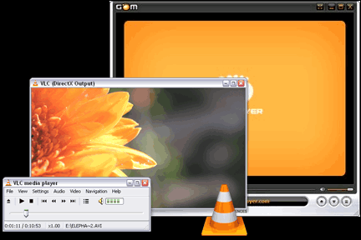
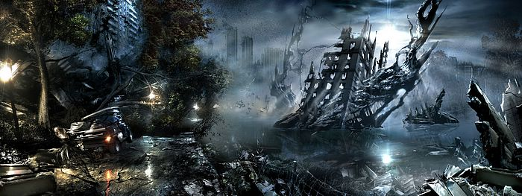
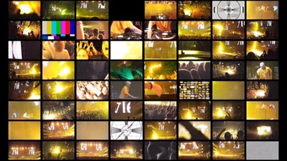

Master-Slave (Software counterpart)
Movie players
High-resolution Game players
Graphics partitioning

Slide 50
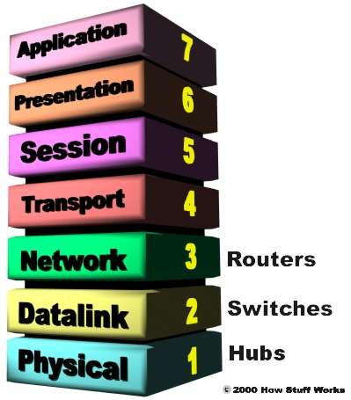
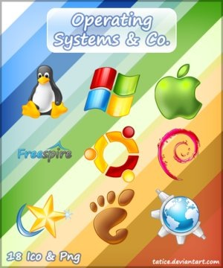
Layers (Software example)
Layers structure applications whose dominant
characteristic is a mix of low- and high- level issues.

Slide 51
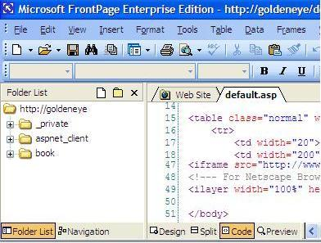
MVC (Software example)
MVC structures interactive applications.

Slide 52
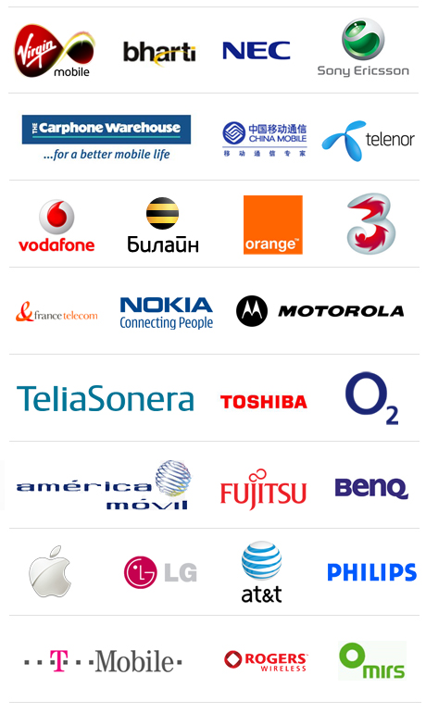
Microkernel (Software example)
Microkernel separates the variant and non-variant
parts of a product-line application.

Slide 53
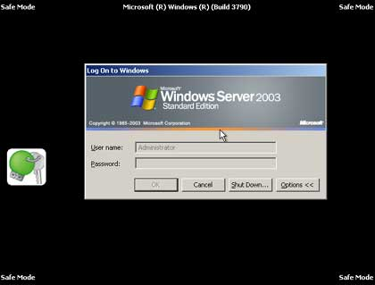
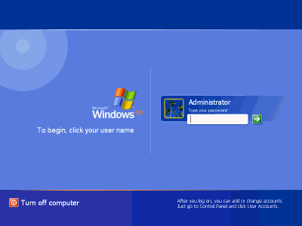
Reflection (Software example)
Reflection pattern provides a mechanism for changing
structure and behavior of a system dynamically.

Slide 54
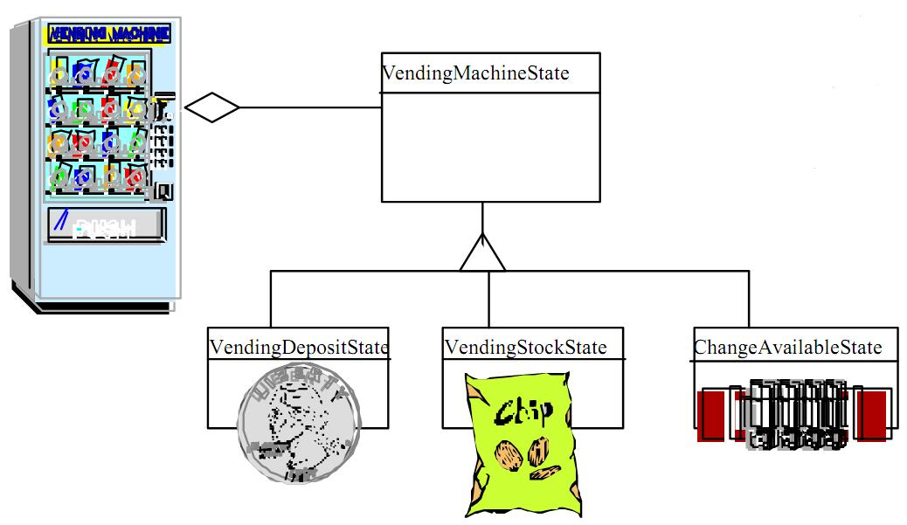
State (Software example)
An object alters its
behavior when its
internal state
changes.

Slide 55
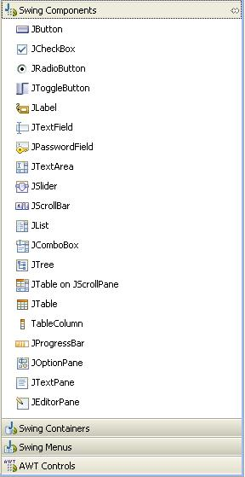
Template Method (Software example)
Event handling in Java GUI
components is unimplemented.
Define the skeleton of an
algorithm in an operation,
deferring some steps to
subclasses.

Slide 56
Observer example

Slide 57

Thank you for ur attention
Questions?

